Slide 1
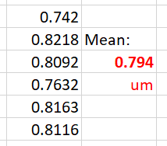
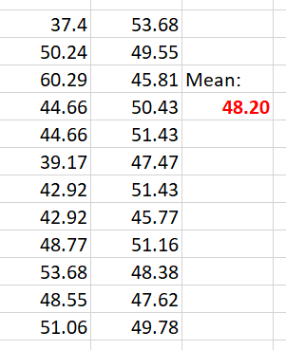
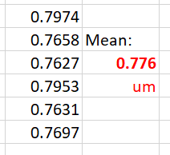
NiPU30
10/30/2019
Fresh 10.5 L bath (2nd time fresh 10.5-L bath was made)
Copper Dummy Profilometer scans:
NS_JT5A monitor for SEM:
START of
RUN
Decided on:
55s Plating Time
→ 53 nm NiP thickness
(based on SEM)
END of
RUN
Profilometer_Step-height
measurement result:
AVE: 785nm for 10min
→ 78.5 nm/min
SEM cross-section result:
48nm for 50 sec (0.83min)
→ 57.8 nm/min

